Slide 1
Lecture 7
Richardson Error Formula

Slide 2
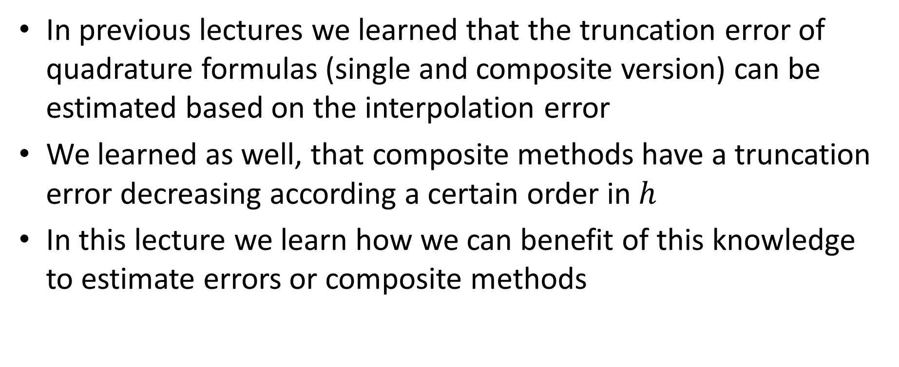
Introduction
In previous lectures we learned that the truncation error of quadrature formulas (single and composite version) can be estimated based on the interpolation error
We learned as well, that composite methods have a truncation error decreasing according a certain order in $h$
In this lecture we learn how we can benefit of this knowledge to estimate errors or composite methods
Notes:
In previous lectures we learned that the truncation error of quadrature formulas (single and composite version) can be estimated based on the interpolation error
We learned as well, that composite methods have a truncation error decreasing according a certain order in $h$
In this lecture we learn how we can benefit of this knowledge to estimate errors or composite methods

Slide 3


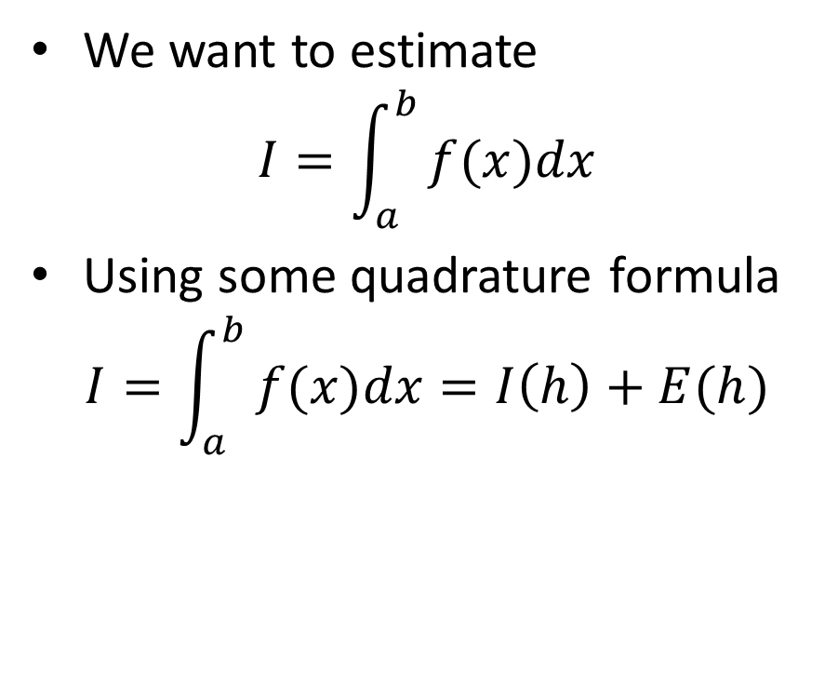











Estimating defined integrals
We want to estimate
$$I=\int_{a}^{b}{⁡f(x)dx}$$
Using some quadrature formula
$$I=\int_{a}^{b}{⁡f(x)dx}=I\left(h\right)+E(h)$$
$$y$$
$$I_{2}$$
$$y=f(x)$$
$$I_{1}$$
Quadrature formula estimation
Error of
quadrature formula
$$x_{1}$$
$$x_{2}$$
$$x_{3}$$
$$x$$
$$a$$
$${=x}_{0}$$
$$b$$
$${=x}_{4}$$
$$h$$
Notes:
Imagine you want to estimate a certain defined integral with a composite quadrature method
We do this by subdividing the integration interval into a chosen number of sub-intervals.
On the graph on the slide we used two sub-intervals.
In each sub-interval we choose interpolations points according the method we want to use
For the example on the slide, we use the Simpson 1/3 rule which means we choose three interpolation points
The choice of number of sub-intervals defines us the quantity h, which is the distance between two interpolating points
Now, when using our composite quadrature formula, we will get, for a given h, an estimation I(h) of the defined integral, and an error E(h).

Slide 4
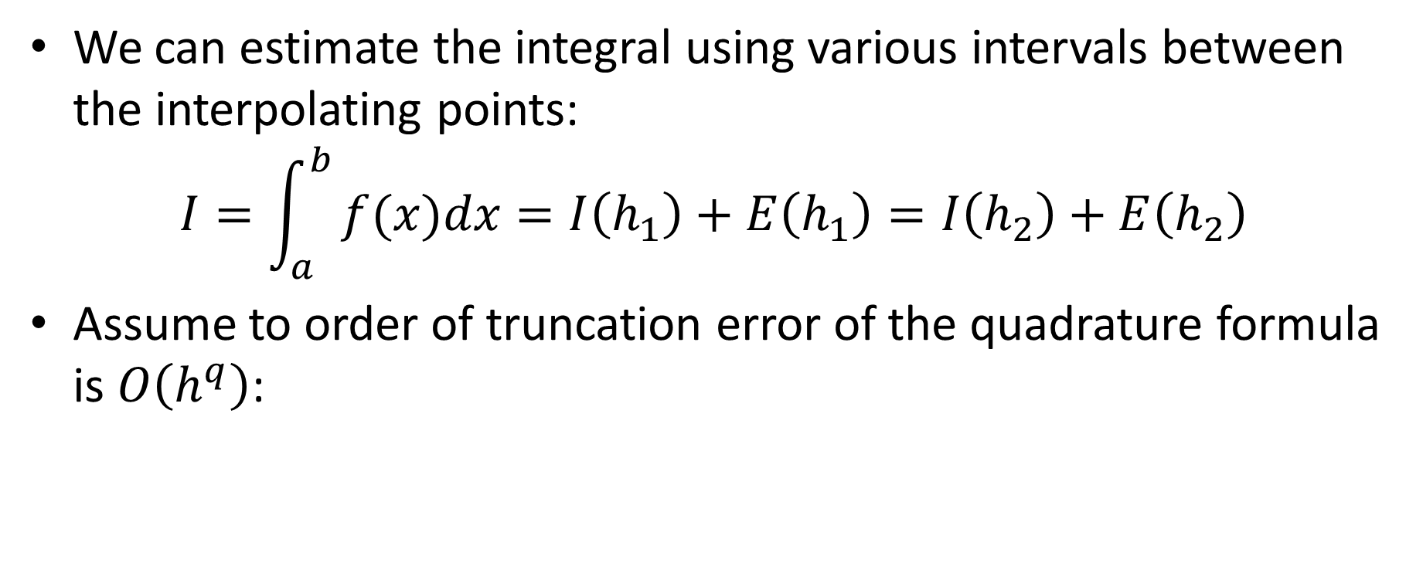

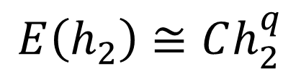
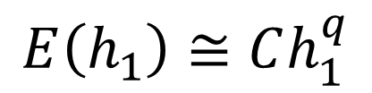
Estimating errors
We can estimate the integral using various intervals between the interpolating points:
$$I=\int_{a}^{b}{⁡f(x)dx}=I\left(h_{1}\right)+E\left(h_{1}\right)=I\left(h_{2}\right)+E\left(h_{2}\right)$$
Assume to order of truncation error of the quadrature formula is $O\left(h^{q}\right)$:
$$E\left(h_{1}\right)≅Ch_{1}^{q}$$
$$\frac{{E(h}_{1})}{E(h_{2})}≅\frac{h_{1}^{q}}{h_{2}^{q}}$$
$$E\left(h_{2}\right)≅Ch_{2}^{q}$$
Notes:
If we want, we can repeat this exercise for different values of h. For example h1 and h2
In that case we can write that our defined integral I is equal to $I\left(h_{1}\right)+E\left(h_{1}\right)$ but as well equal to $I\left(h_{2}\right)+E\left(h_{2}\right)$
Let us now consider a quadrature formula where the order of the truncation error is q. Or in other words is in $O\left(h^{q}\right)$
What does that imply?
We can write two equations
On one side
$$E\left(h_{1}\right)≅Ch_{1}^{q}$$
And on the other side
$$E\left(h_{2}\right)≅Ch_{2}^{q}$$
Combining these equations we get that the ratio of the errors ${E(h}_{1})$ and $E(h_{2})$ is approximatively equal to the ratio of h1 and h2 to the power q

Slide 5

Richardson Error Formula
In summary we have two equations:
$$I\left(h_{1}\right)+E\left(h_{1}\right)=I\left(h_{2}\right)+E\left(h_{2}\right)$$
$$\frac{{E(h}_{1})}{E(h_{2})}≅\frac{h_{1}^{q}}{h_{2}^{q}}$$
Combining them results in
$$I\left(h_{1}\right)+\frac{h_{1}^{q}}{h_{2}^{q}}E\left(h_{2}\right)≅I\left(h_{2}\right)+E\left(h_{2}\right)$$
Solving for $E\left(h_{2}\right)$
$$E\left(h_{2}\right)≅\left|\frac{I\left(h_{2}\right)−I\left(h_{1}\right)}{{\left(\frac{h_{1}}{h_{2}}\right)}^{q}−1}\right|$$
Notes:
In summary we have two equations
The first one is
$$I\left(h_{1}\right)+E\left(h_{1}\right)=I\left(h_{2}\right)+E\left(h_{2}\right)$$
And the second one is
$$\frac{{E(h}_{1})}{E(h_{2})}≅\frac{h_{1}^{q}}{h_{2}^{q}}$$
We can combine them by solving the second for E(h1) and plugging it it into the first one
If we further solve for E(h2), we get an estimation of the error of our quadrature formula when we use a step size h2
This formula is known as the Richardson error formula

Slide 6
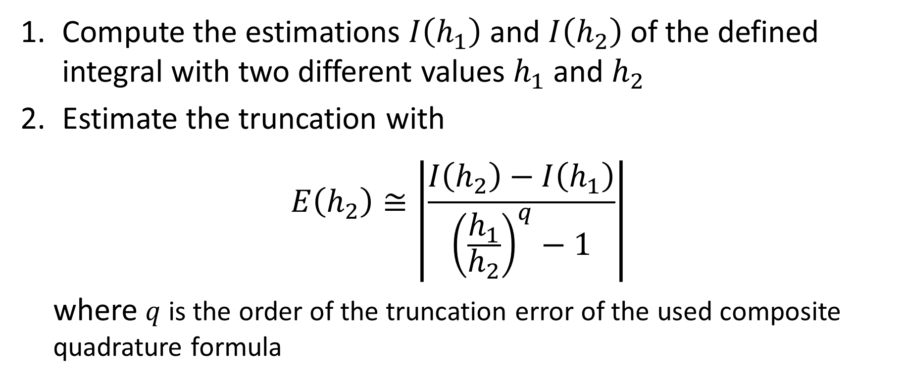
Estimating truncation errors for composite methods
Compute the estimations $I\left(h_{1}\right)$ and $I\left(h_{2}\right)$ of the defined integral with two different values $h_{1}$ and $h_{2}$
Estimate the truncation with
$$E\left(h_{2}\right)≅\left|\frac{I\left(h_{2}\right)−I\left(h_{1}\right)}{{\left(\frac{h_{1}}{h_{2}}\right)}^{q}−1}\right|$$
where $q$ is the order of the truncation error of the used composite quadrature formula
Notes:
The Richardson error formula is very useful to estimate the error in practical applications
For this we proceed in two steps
First: we compute the estimations $I\left(h_{1}\right)$ and $I\left(h_{2}\right)$ of the defined integral with two different values $h_{1}$ and $h_{2}$ using our quadrature formula
Second, we estimate our truncation error using the Richardson formula
Recall that $q$ is the order of the truncation error of the used composite quadrature formula

Slide 7
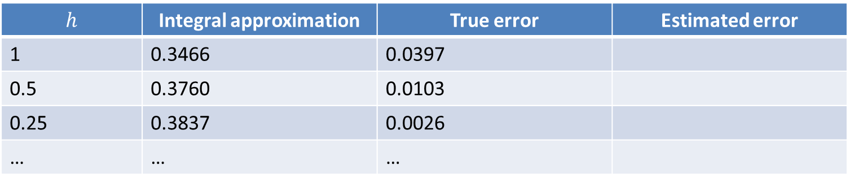
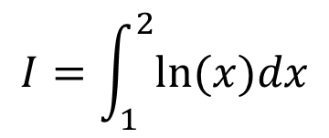
Illustration
$$I=\int_{1}^{2}{ln⁡(x)dx}$$
Composite trapezoid formula
Order of truncation error : 2
$$h$$ | Integral approximation | True error | Estimated error
1 | 0.3466 | 0.0397
0.5 | 0.3760 | 0.0103
0.25 | 0.3837 | 0.0026
… | … | …
Notes:
Let us apply this method for an example
We consider our favorite defined integral between 1 and 2 of the natural log function
Let us use the composite Trapezoid rule
We compute approximations of our integral with various step sizes
I filled as well the column of the true error based on the known true answer of the defined integral

Slide 8
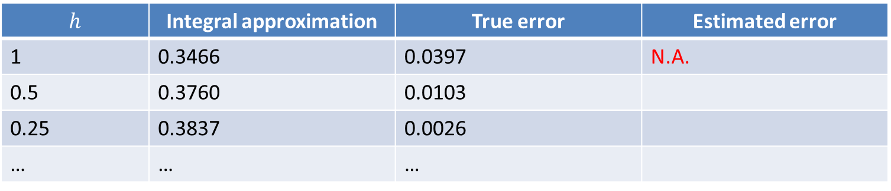
Illustration
$$I=\int_{1}^{2}{ln⁡(x)dx}$$
Composite trapezoid formula
Order of truncation error : 2
$$h$$ | Integral approximation | True error | Estimated error
1 | 0.3466 | 0.0397 | N.A.
0.5 | 0.3760 | 0.0103
0.25 | 0.3837 | 0.0026
… | … | …
Notes:
Les us now check if the Richardson error formula is able to estimate properly these errors
For this we apply the Richardson error formula and fill the last column of the table
For h=1 we can not give any approximation as we don’t have two estimations of the integral with two different step sizes

Slide 9
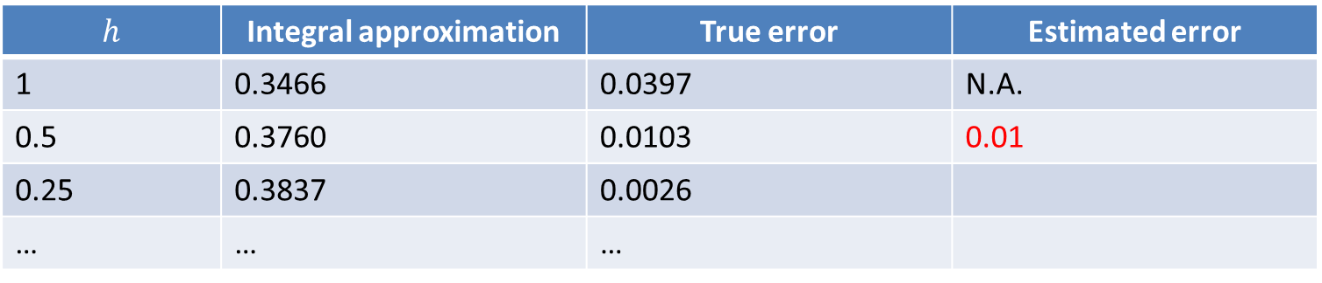
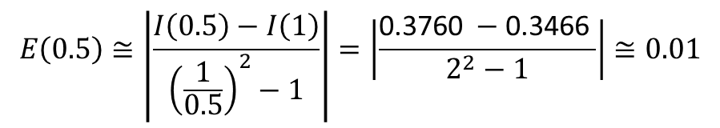
Illustration
$$I=\int_{1}^{2}{ln⁡(x)dx}$$
Composite trapezoid formula
Order of truncation error : 2
$$h$$ | Integral approximation | True error | Estimated error
1 | 0.3466 | 0.0397 | N.A.
0.5 | 0.3760 | 0.0103 | 0.01
0.25 | 0.3837 | 0.0026
… | … | …
$$E\left(0.5\right)≅\left|\frac{I\left(0.5\right)−I\left(1\right)}{{\left(\frac{1}{0.5}\right)}^{2}−1}\right|=\left|\frac{\text{0.3760 }−\text{0.3466 }}{2^{2}−1}\right|≅0.01$$
Notes:
For h=05 we can give such an approximation
For this we use the computed estimations of the integral with h=1 and h=0.5
The Richardson error formula estimates the error to be about 0.01
This is a really good match with the true error

Slide 10
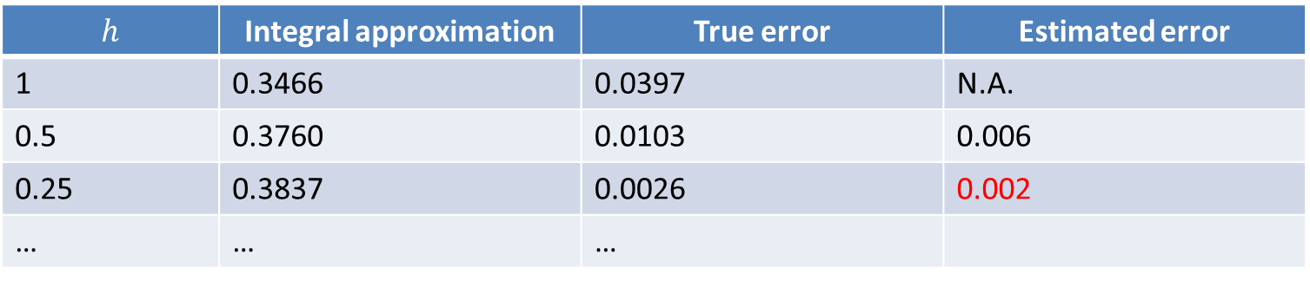
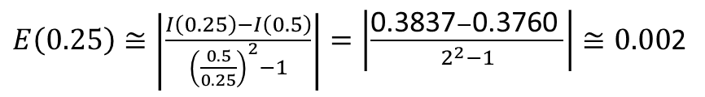
Illustration
$$I=\int_{1}^{2}{ln⁡(x)dx}$$
Composite trapezoid formula
Order of truncation error : 2
$$h$$ | Integral approximation | True error | Estimated error
1 | 0.3466 | 0.0397 | N.A.
0.5 | 0.3760 | 0.0103 | 0.006
0.25 | 0.3837 | 0.0026 | 0.002
… | … | …
$E\left(0.25\right)≅\left|\frac{I\left(0.25\right)−I\left(0.5\right)}{{\left(\frac{0.5}{0.25}\right)}^{2}−1}\right|=\left|\frac{\text{0.3837}−\text{0.3}\text{7}\text{6}\text{0} }{2^{2}−1}\right|≅0.00$2
Notes:
We can repeat the same exercise to estimate the error when we use h=0.25
For this we use the computed estimations of the integral with h=0.5 and h=0.25
The Richardson error formula estimates the error to be about 0.002
This is again an excellent match with the true error

Slide 11

Illustration
$$O\left(h^{2}\right)$$
Notes:
We can proceed like this further
On the graph is displayed the true error in function of h and the estimation based on Richardson's error formula
Note how well they match
Fitting a power law to the results further confirms that the truncation error decreases indeed in order h square

Slide 12

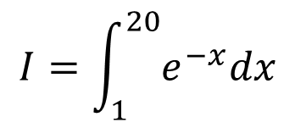
Issue with error estimations
Error underestimation
$$I=\int_{1}^{20}{e^{−x}dx}$$
$$O\left(h^{2}\right)$$
Notes:
Does the Richardson error formula always estimate correctly the error?
Unfortunately not always
In fact, if h is too large the assumptions behind the Richardson error formula are no longer valid
To demonstrate this effect, let us consider the defined integral between 1 and 20 of $e^{−x}$
We use again the composite Trapezoid rule to estimate this integral
The graph displays the true error as well as the estimated error using Richardson’s formula
For large values of h, the error estimation is too optimistic and we underestimate the error
The good news is that even if we don’t know the true error, as it would be the case in a real situation, we can still know that Richardson's error formula did a wrong estimation
For this we add the trend the truncation error should follow. In the case of the composite Trapezoid method this is in second order in h
It becomes now obvious that for too large values of h something went wrong as the estimated error does not follow the trend it should

Slide 13

Typical Richardson Error Estimation Behavior
Truncation error $O\left(h^{q}\right)$
Assumptions for
Richardson error formula
not valid
Log(Error)
Round-off error
Log(h)
Notes:
Let us summarize how Richardson error estimation will typically behave
The plot displays this typical behavior
For intermediate values of h, which are values neither too small nor too large, the error decreases according the trend it should based on the order of the used method
For small values of h, the error will typically start to increase
We discussed this effect already several times and we know now that this is due to round-off errors
For large values of h, the error will not follow the order of the method. This is because the assumptions used in the derivation of the Richardson error formula are no longer valid
The error may be underestimated as in our example, but it can be over-estimated too
But the key point to understand here is that based on the plot of the estimated error in function of h, we can know in which region we estimate correctly the error. It is for values h such that the error decreases according the known order of the used quadrature formula

Slide 14

Application
Estimate the value of the error function in $z=3$
$$\text{Erf}(z)=\frac{2}{\sqrt{π}}\int_{0}^{z}{e^{−x^{2}}dx}$$
with an absolute error less than ${10}^{−12}$
Notes:
Let us finish this lecture by doing an application
We want to estimate the value of the error function in z=3
Recall that the error function is an important function in probability and statistics
However, it is not possible to calculate it with analytical ways
Only numerical approximations can be given
Our aim here is to give the approximation with an absolute error less than ${10}^{−12}$

Slide 15
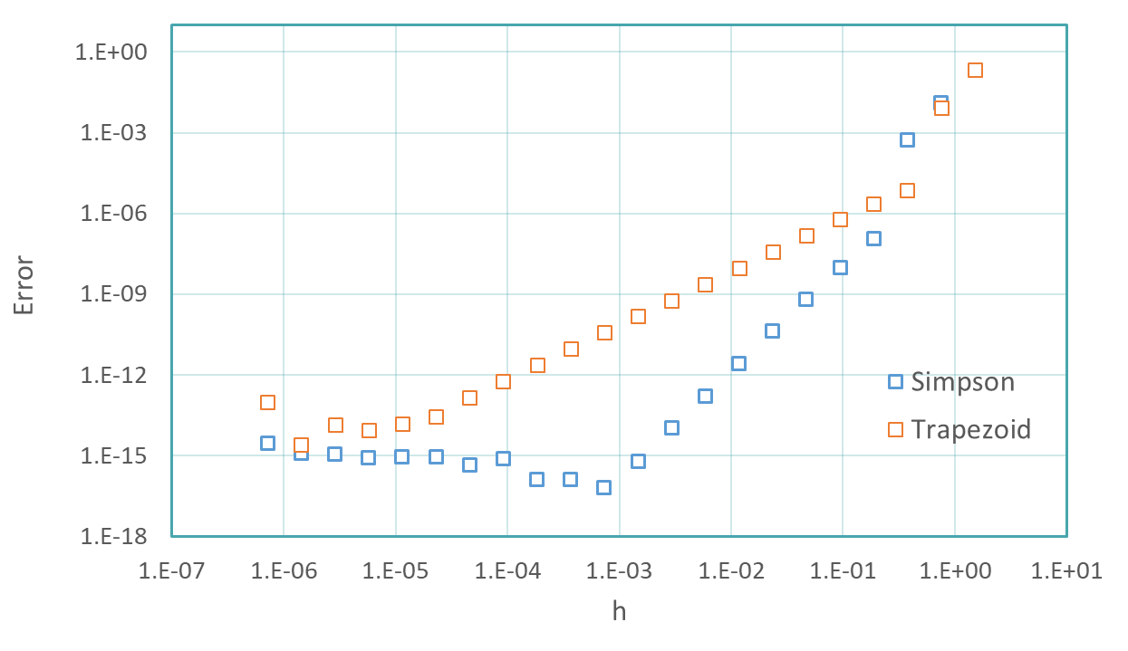
Application
Targeted error
Targeted error
Notes:
For this we use the composite trapezoid and Simpson 1/3 rule
To estimate the error, we use the Richardson error formula
The displayed graph shows the results of these calculations
As a first step, we need to identify the interval of h for which the Richardson formula is valid
For this we look for the region where the error decreases according the known order
For the Trapezoid rule this is in order two
And for the Simpson 1/3 this is order four
Both regions can be clearly identified on the graph
Note how for lower values the error is increasing and how for large values of h, the error doesn’t follow the expected trend
Our targeted error is ${10}^{−12}$
Both methods, Trapezoid and Simpson 1/3 are able to reach this precision
For the trapezoid rule a value ${h=10}^{−4}$ is required
For Simpson’s 1/3 a value of ${10}^{−2}$ is enough
Note that if we would like to reach a higher precision, for example ${10}^{−15}$, only Simpson's 1/3 rule can reach it
For the trapezoid method, the round off errors are too large

Slide 16
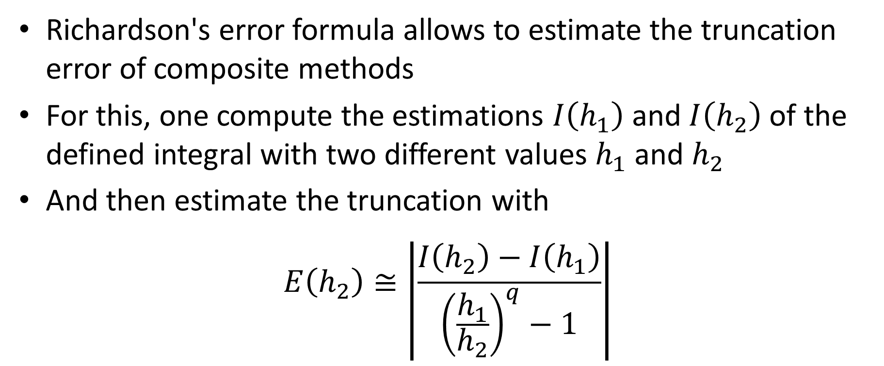
Summary
Richardson's error formula allows to estimate the truncation error of composite methods
For this, one compute the estimations $I\left(h_{1}\right)$ and $I\left(h_{2}\right)$ of the defined integral with two different values $h_{1}$ and $h_{2}$
And then estimate the truncation with
$$E\left(h_{2}\right)≅\left|\frac{I\left(h_{2}\right)−I\left(h_{1}\right)}{{\left(\frac{h_{1}}{h_{2}}\right)}^{q}−1}\right|$$
Notes:
Let us summarize the key findings
Richardson's error formula allows to estimate the truncation error of composite methods
For this, one compute the estimations $I\left(h_{1}\right)$ and $I\left(h_{2}\right)$ of the defined integral with two different values $h_{1}$ and $h_{2}$
And then estimate the truncation with
$$E\left(h_{2}\right)≅\left|\frac{I\left(h_{2}\right)−I\left(h_{1}\right)}{{\left(\frac{h_{1}}{h_{2}}\right)}^{q}−1}\right|$$

